Slide 2


Can you name the shape?
Click here to reveal the answer
cone

Slide 3
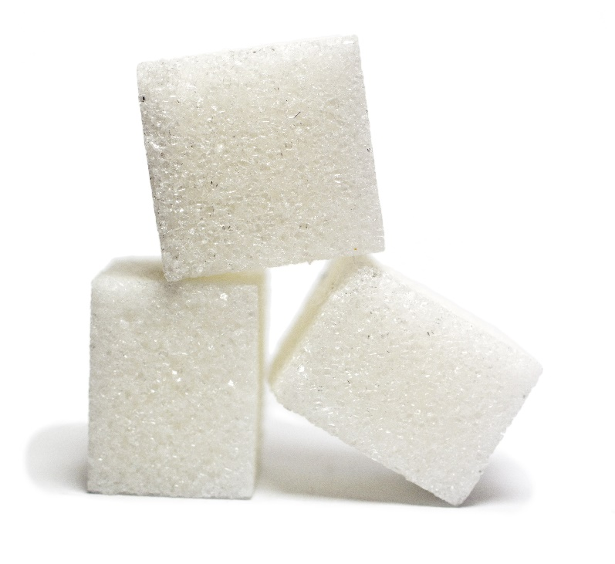

Can you name the shape?
Click here to reveal the answer
cube

Slide 4
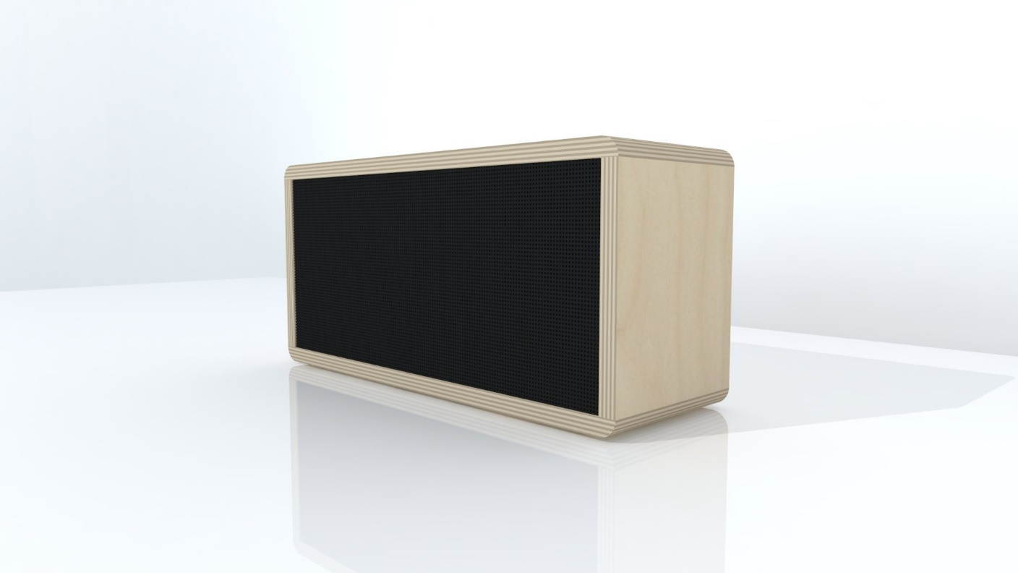
Can you name the shape?
Click here to reveal the answer
cuboid

Slide 5
Can you name the shape?
Click here to reveal the answer
Rectangular prism

Slide 6
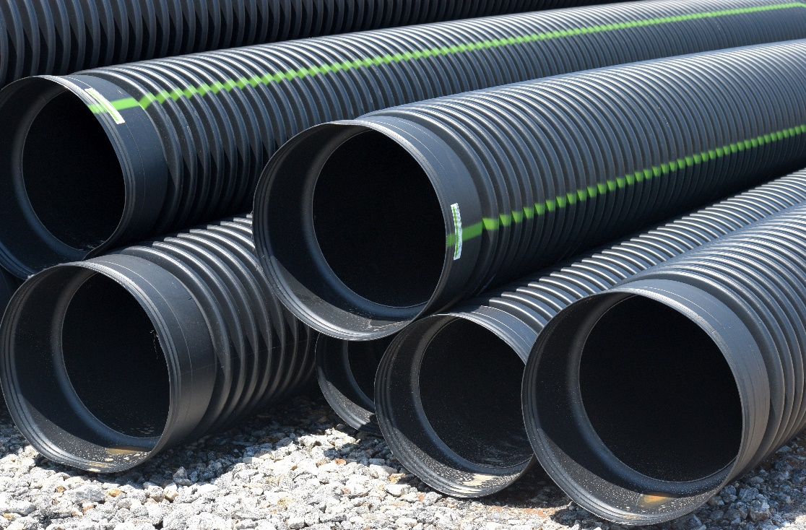
Can you name the shape?
Click here to reveal the answer
cylinder

Slide 7
Can you name the shape?
Click here to reveal the answer
circular prism

Slide 8
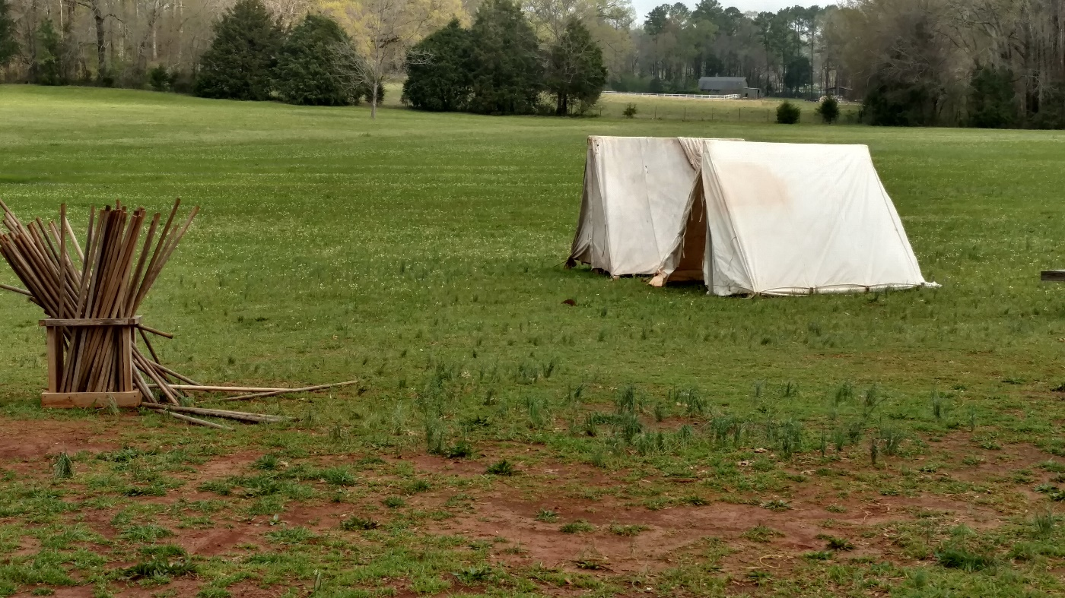
Can you name the shape?
Click here to reveal the answer
triangular prism

Slide 9
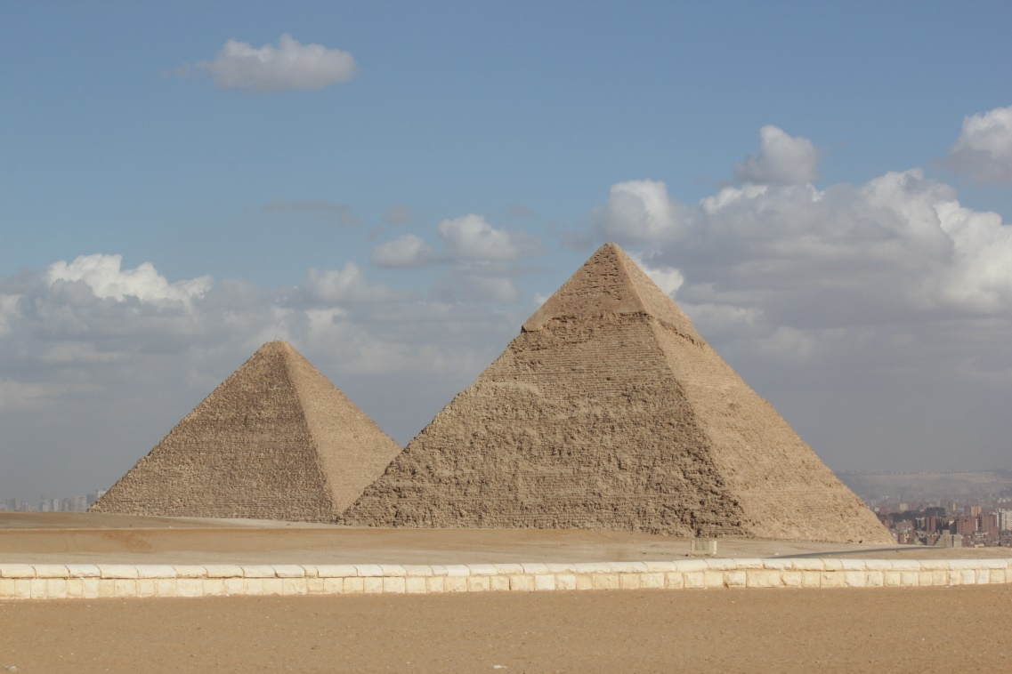
Can you name the shape?
Click here to reveal the answer
pyramid

Slide 10
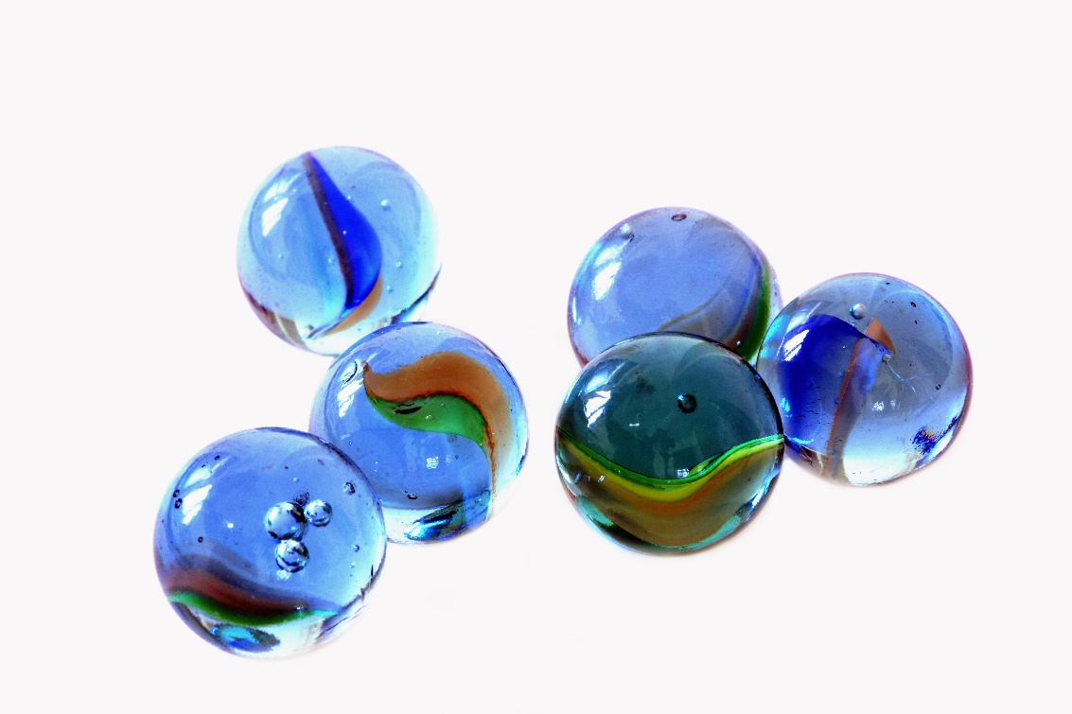
Can you name the shape?
Click here to reveal the answer
sphere

